Slide 1


<NotADBTalk />
by Martin Chaov

Slide 2



What do I work on?
10+ years on prod
20 000+ live events monthly
Millions of users
Used to be monolith
On-going feature development
CMS
Regulatory features
White Label Gaming license
3rd Party
Gaming Content
Agent
System
Payment
Gateway
Content
Management
System (CMS)
Betting Shops & Retail Management
Affiliate
System
CRM
Reporting & BI
Retention & Loyalty
Management

Slide 3

Who is in the audience?
DBAs?
Developers?
Front-end devs?
POs?
Who else?
Notes:
Enough about me! Guys, tell me few things about you. Please raise hand if you are:
- a developer
- a DBA
- fe dev?!
- PO
People who didn't raise their hands, just should out - what do you do?

Slide 4



Do you like legacy software?

Slide 5

Legacy
A gift from the past,
that helps create a better future...
… said no developer ever!

Slide 6
SQL
Invented 1974
System R
Notes:
(45 years old)
IBM System R is a database system built as a research project at IBM's San Jose Research Laboratory beginning in 1974. System R was a seminal project: it was the first implementation of SQL.
System R, an experimental database system, was constructed to demonstrate that the usability advantages of the relational data model can be realized in a system with the complete function and high performance required for everyday production use.
IBM endorsed SQL originally, when it decided to build what became DB2. IBM used to be more of a force in the marketplace than it is today.
One effect of that state of affairs was that-in what might be seen as a self-fulfilling prophecy…
…competitors simply assumed that SQL was going to become a big deal in the marketplace, and so they jumped on the SQL bandwagon very early on, with the consequence that SQL became a kind of de facto standard anyway.
System R implementers were interested primarily in showing that a relational-or “relational”-DBMS could achieve reasonable performance.
They weren’t so interested in the form or quality of the user interface. In fact, some of them, at least, freely admitted that they weren’t language designers as such.
System R and it's descendants. 1970s is when SQL was invented as a POC by people who didn't design programming languages, and didn't know anything about it.
https://www.red-gate.com/simple-talk/opinion/opinion-pieces/chris-date-and-the-relational-model/

Slide 7

Hardware in 1974?
HDD – 200 MB | 38.3 Ms | 37 000.00 $ | 185.00 $/MB
RAM – 0.00098 Kbyte | 0.70 $ | 734 003.00 $/MB
CPU – 2.083 MHz | 110 550.00 $
Notes:
What was the state of the art hardware in 1974?
Writing to the HDD was expensive operation!
Large databases have historically been kept on disk drives. The time to read a record on a disk drive far exceeds the time needed to compare keys once the record is available. The time to read a record from a disk drive involves a seek time and a rotational delay. The seek time may be 0 to 20 or more milliseconds, and the rotational delay averages about half the rotation period. For a 7200 RPM drive, the rotation period is 8.33 milliseconds.
Naively, then, the time to locate one record out of a million would take 20 disk reads times 10 milliseconds per disk read, which is 0.2 seconds.
The time won't be that bad because individual records are grouped together in a disk block. A disk block might be 16 kilobytes. If each record is 160 bytes, then 100 records could be stored in each block. The disk read time above was actually for an entire block. Once the disk head is in position, one or more disk blocks can be read with little delay. With 100 records per block, the last 6 or so comparisons don't need to do any disk reads—the comparisons are all within the last disk block read.
To speed the search further, the first 13 to 14 comparisons (which each required a disk access) must be sped up.
A significant improvement can be made with an index. In the example above, initial disk reads narrowed the search range by a factor of two. That can be improved substantially by creating an auxiliary index that contains the first record in each disk block (sometimes called a sparse index). This auxiliary index would be 1% of the size of the original database, but it can be searched more quickly. Finding an entry in the auxiliary index would tell us which block to search in the main database; after searching the auxiliary index, we would have to search only that one block of the main database—at a cost of one more disk read. The index would hold 10,000 entries, so it would take at most 14 comparisons. Like the main database, the last six or so comparisons in the auxiliary index would be on the same disk block. The index could be searched in about eight disk reads, and the desired record could be accessed in 9 disk reads.
The trick of creating an auxiliary index can be repeated to make an auxiliary index to the auxiliary index. That would make an aux-aux index that would need only 100 entries and would fit in one disk block.
Instead of reading 14 disk blocks to find the desired record, we only need to read 3 blocks. This blocking is the core idea behind the creation of the B-tree, where the disk blocks fill-out a hierarchy of levels to make up the index. Reading and searching the first (and only) block of the aux-aux index which is the root of the tree identifies the relevant block in aux-index in the level below. Reading and searching that aux-index block identifies the relevant block to read, until the final level, known as the leaf level, identifies a record in the main database. Instead of 150 milliseconds, we need only 30 milliseconds to get the record.
The auxiliary indices have turned the search problem from a binary search requiring roughly log2 N disk reads to one requiring only logb N disk reads where b is the blocking factor (the number of entries per block: b = 100 entries per block in our example; log100 1,000,000 = 3 reads).
In practice, if the main database is being frequently searched, the aux-aux index and much of the aux index may reside in a disk cache, so they would not incur a disk read.
Mention insertions and deletions…

Slide 8
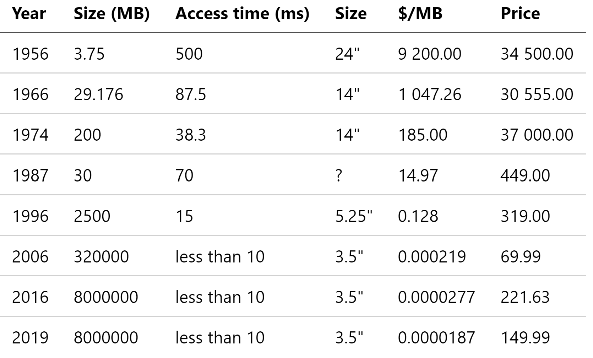
More hardware - HDDs
Notes:
Just for fun, let’s see how HDDs progressed throughout the years.

Slide 9
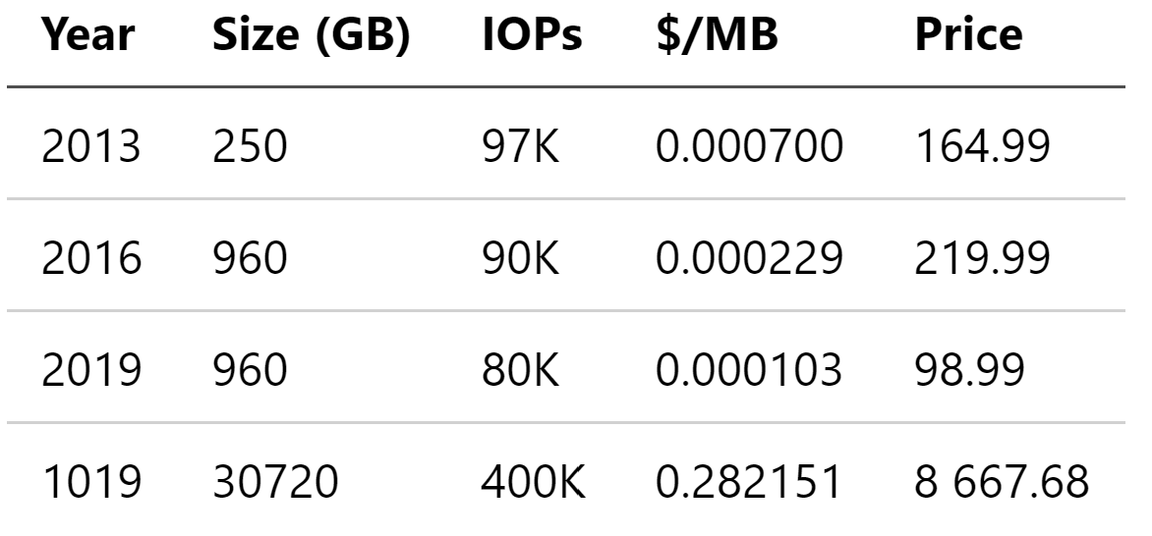
More hardware SSDs
Notes:
And SSDs?

Slide 10
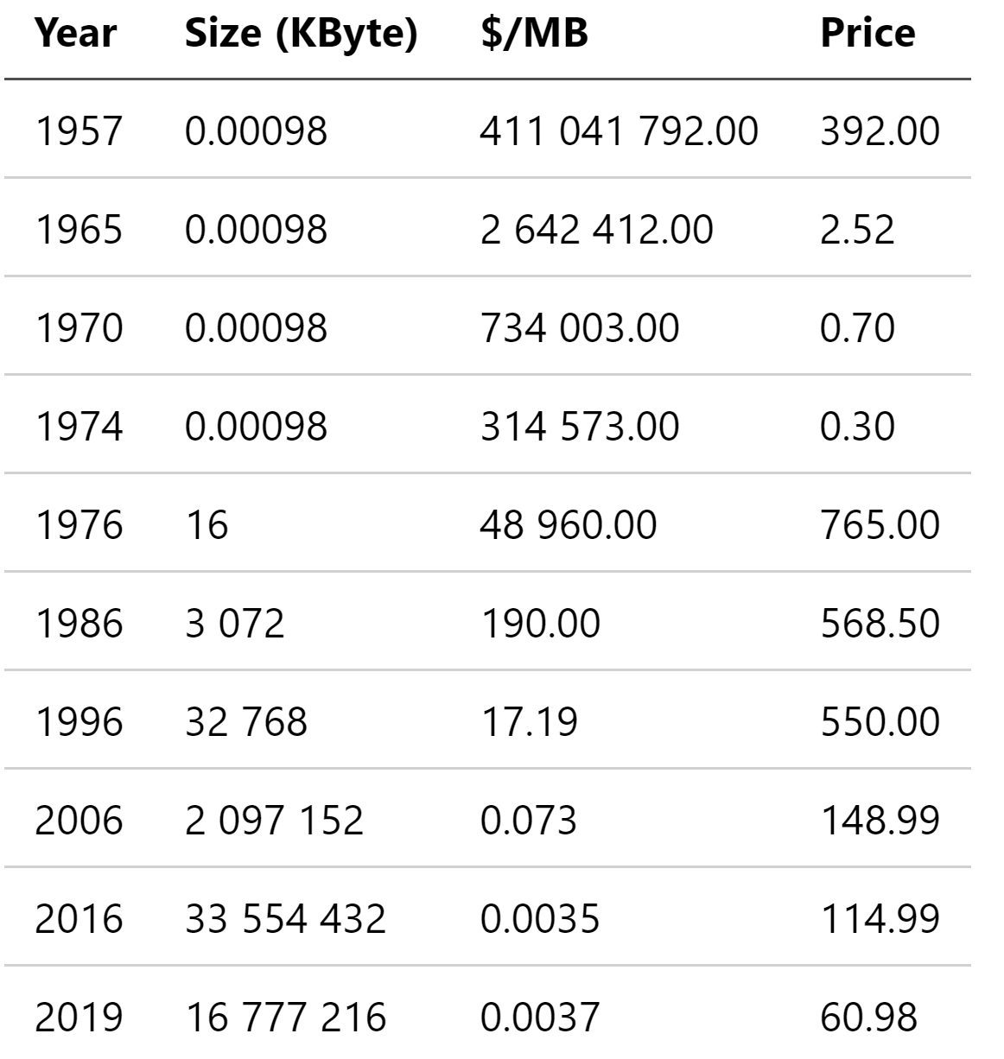
More hardware RAM
Notes:
What about RAM?
// KByte / 1000 = MB
// KByte * 8000 = Bit
// 0.00098 KByte = 7.84 Bit

Slide 11
The SQL
Notes:
So let’s get back to SQL… It looks like technical limitations are not the reason to still use SQL as the “data” language…
May we agree so?
Okay then, so why do we use it for 45 years? Is it really that good?
What problem is SQL solving for us?

Slide 12

“I really question whether SQL is more user friendly than predicate calculus”
Chris Date
Notes:
Chris Date (born 1941) is an independent author, lecturer, researcher, and consultant, specializing in relational database theory.
While working at IBM he was involved in technical planning and design for the IBM products SQL/DS and DB2. He was also involved with Edgar F. Codd’s relational model for database management. He left IBM in 1983 and has written extensively of the relational model, in association with Hugh Darwen.
Chris Date is the author of several books, including:
- An Introduction to Database Systems, ISBN 0-321-19784-4
- A Guide to the SQL standard, 4th ed., Addison Wesley, USA 1997, ISBN 978-0-201-96426-4
- Databases, Types, and the Relational Model, The Third Manifesto (with Hugh Darwen), ISBN 0-321-39942-0
- Temporal Data & the Relational Model, ISBN 1-55860-855-9
- Database in Depth: Relational Theory for Practitioners, ISBN 0-596-10012-4
- Several volumes of Relational Database Writings: ISBN 0-201-39814-1, ISBN 0-201-82459-0, ISBN 0-201-54303-6, ISBN 0-201-50881-8.
- What Not How: The Business Rules Approach to Application Development, ISBN 0-201-70850-7
- The Database Relational Model: A Retrospective Review and Analysis, ISBN 0-201-61294-1
- SQL and Relational Theory, 2nd Edition: How to Write Accurate SQL Code, ISBN 1-4493-1640-9.

Slide 13
Oh, SQL, you so funny!
2PC
Undo/Redo logs
NULL
Distributed DBs
Notes:
Let me ask you a question, what are the biggest bottlenecks in DBs like MSSQL, MySQL, Oracle, PosgreSQL.
- Undo/redo log
- 2PC
So where is this comming from, how did we get here? Let's go back 50 years :D to the 1970s.

Slide 14
NULL == UNDEFINED
Notes:
The “undefined” value, i.e., the value that is not yet defined (probably for technical reasons) but may well be defined later. Think about a person that we want to add to the database in order to use it in other tables. At some later stage, we’ll add that person’s job.
https://www.vertabelo.com/blog/technical-articles/50-shades-of-null-or-how-a-billion-dollar-mistake-has-been-stalking-a-whole-industry-for-decades

Slide 15

NULL == UNKNOWN
Notes:
The “unknown” value, i.e., the value that we do not know (and may never know). Perhaps we can no longer ask this person or their relatives about their birth date – the info will be forever lost. But we still want to model the person, so we use NULL in the sense of UNKNOWN (which is its true meaning in SQL, as we’ll see later on).
https://www.vertabelo.com/blog/technical-articles/50-shades-of-null-or-how-a-billion-dollar-mistake-has-been-stalking-a-whole-industry-for-decades

Slide 16

NULL == OPTIONAL
Notes:
The “optional” value, i.e., the value that doesn’t need to be defined. Note that the “optional” value also appears in the case of an OUTER JOIN, when the outer join doesn’t produce any values on one side of the relationship. Or also when using GROUPING SETS, where different combinations of GROUP BY columns are combined (or left empty).
I love optional values. Somewhere around all the null checks you could glimpse some business logic!
https://www.vertabelo.com/blog/technical-articles/50-shades-of-null-or-how-a-billion-dollar-mistake-has-been-stalking-a-whole-industry-for-decades

Slide 17

NULL
NULL == DELETED
NULL == AVOIDED
Notes:
The “deleted” or “avoided” value, i.e., the value that we don’t want to specify. Perhaps we usually register a person’s marital status as is done in some jurisdictions, but not in others, where it is not legal to register any personal data of this type. Hence, we don’t want to know this value in some cases.
https://www.vertabelo.com/blog/technical-articles/50-shades-of-null-or-how-a-billion-dollar-mistake-has-been-stalking-a-whole-industry-for-decades

Slide 18

NULL == SPECIAL
Notes:
The “special” value in a given context, i.e., the value that we cannot model otherwise in the range of possible values. This is often done when working with date ranges. Let’s assume a person’s job is bounded by two dates, and if the person is currently working in that position, we’ll use NULL to say that the period is unbounded at the end of the date range.
https://www.vertabelo.com/blog/technical-articles/50-shades-of-null-or-how-a-billion-dollar-mistake-has-been-stalking-a-whole-industry-for-decades

Slide 19

NULL by accident
Notes:
The “accidental” NULL, i.e., the NULL value that is just NULL because developers didn’t pay attention. In the absence of an explicit NOT NULL constraint, most databases assume for columns to be nullable. And once columns are nullable, developers might just “accidentally” put NULL values in their rows, where they didn’t even intend to.
One thing that is frequently forgotten when dealing with SQL’s NULL is that it formally implements the UNKNOWN case, which is a special value that is part of so-called three-valued logic, and it does so, inconsistently, e.g. in the case of UNION or INTERSECT operations.
https://www.vertabelo.com/blog/technical-articles/50-shades-of-null-or-how-a-billion-dollar-mistake-has-been-stalking-a-whole-industry-for-decades

Slide 20


Slide 21
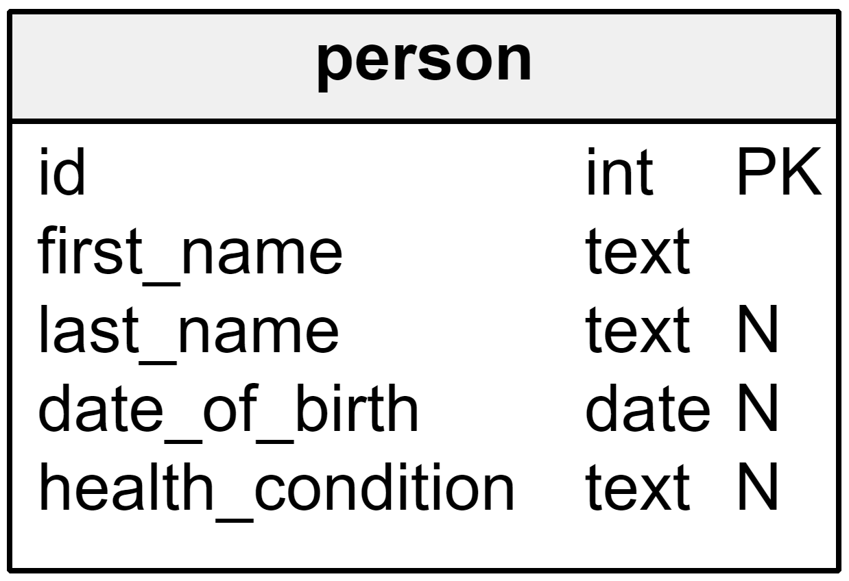

Slide 22

Notes:
If, for instance, we want to find all people who are not registered as being health_condition, intuitively, we’d like to write the following statement

Slide 23

Notes:
Unfortunately, because of three-valued logic and SQL’s NULL, the above query will not return those values that do not have any explicit health_condition. Hence, we’ll need to write an additional, explicit predicate:

Slide 24
Notes:
Or, we coerce the value to some NOT NULL value prior to comparing it:

Slide 25

Notes:
Three valued logic is hard. And it isn’t the only problem with NULL in SQL. Here are more disadvantages of using NULL:
- There is only one NULL, when we really wanted to encode several different “absent” or “special” values. The range of useful special values highly depends on the domain and the data types that are used. Yet, domain knowledge is always required to correctly interpret the meaning of a nullable column, and queries must be designed carefully in order to prevent the wrong results from being returned, as we saw above.
- Again, three-valued logic is very hard to get right. While the above example is still rather simple, what do you think the following query will yield?

Slide 26

Notes:
Exactly. It will not yield anything at all, as explained in this article here. In short, the above query is the same as the below one:

Slide 27

Notes:
The Oracle database treats NULL and the empty string '' as the same thing. This is very tricky as you won’t immediately notice why the following query always returns an empty result:

Slide 28
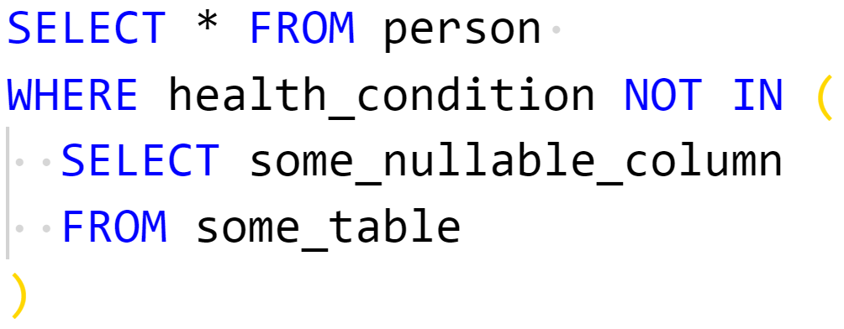
Notes:
Oracle (again) doesn’t put NULL values in indexes. This is the source of many nasty performance issues, e.g., when you’re using a nullable column in a NOT IN predicate as such:
With Oracle, the above anti-join will result in a full table scan, regardless if you have an index on some_nullable_column. Because of three-valued logic and because Oracle doesn’t put NULLs in indexes, the engine will need to hit the table and check every value just to be sure there isn’t at least one NULL value in the set, which would make the whole predicate UNKNOWN.

Slide 29
Back to reality…

Slide 30
3rd Party
Gaming Content
White Label Gaming license
Agent
System
Payment
Gateway
Content
Management
System (CMS)
Betting Shops & Retail Management
Affiliate
System
CRM
Reporting & BI
Retention & Loyalty
Management
Notes:
Let me take you back to this picture for a while..
What was the hardest thing to un-monolithize from it?
DB per site
One DB
Stored Procedures

Slide 31
So, what about NoSQL?

Slide 32
Why?
Less complexity
Hight throughput
Horizontally scalable
Avoid ORMs
Less complexity and hardware requirements
Customized solutions
Less workarounds

Slide 33

The end of an architectural era
Michael Stonebraker

Slide 34
Summary of the paper
SQL is not the answer
“one size fits all”
Huge shift in market needs
No Knobs
High availability
Notes:
In the last quarter of a century, there has been a dramatic shift in:
1. DBMS markets: from business data processing to a
collection of markets, with varying requirements
2. Necessary features: new requirements include shared
nothing support and high availability
3. Technology: large main memories, the possibility of
hot standbys, and the web change most everything
The result is:
1. The predicted demise of “one size fits all”
2. The inappropriateness of current relational
implementations for any segment of the market
3. The necessity of rethinking both data models and query
languages for the specialized engines, which we expect
to be dominant in the various vertical markets

Slide 35
Result of paper
H-base prototype
VoltDB
Notes:
If you have enough smart people you should consider Cassandra … if not … VoltDB is a very good option

Slide 36
What are the options?
NoSQL
Key-Value stores
Column oriented
Map-Reduce
Graph DBs
Data flow systems

Slide 37
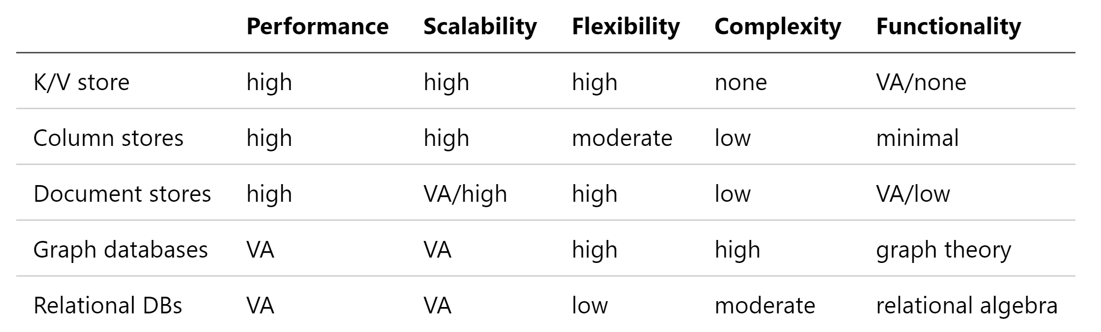

Slide 38
So, when do we choose the database?
Notes:
Mention New York times.

Slide 39


Slide 40


Slide 41

Connect ☺
LinkedIn: https://goo.gl/CRRJ2Y
Mail: martin.c@sbtech.com
Github: https://github.com/mchaov

Slide 42
References
50 Shades of NULL – The Different Meanings of NULL in SQL (https://www.vertabelo.com/blog/technical-articles/50-shades-of-null-or-how-a-billion-dollar-mistake-has-been-stalking-a-whole-industry-for-decades)
The End of an Architectural Era 2007

